Slide 1
Number Notation
When dealing with numerical values, it is often convenient to use the familiar decimal notation.
Consider, for example, the number 93, which is represented by the 8-bit binary number 01011101. If this value is to be used as an immediate operand, it can be given as a decimal number, as in the instruction
ADDI R2, R3, 93
or as a binary number identified by an assembler-specific prefix symbol such as a percent sign, as in
ADDI R2, R3, %01011101

Slide 2
Binary numbers can be written more compactly as hexadecimal, or hex, numbers, in which four bits are represented by a single hex digit. The first ten patterns 0000, 0001, . . . , 1001, referred to as binary-coded decimal (BCD), are represented by the digits 0, 1, . . . , 9.
The remaining six 4-bit patterns, 1010, 1011, . . . , 1111, are represented by the letters A, B, . . . , F. In hexadecimal representation, the decimal value 93 becomes 5D.

Slide 3
Assembler Directives
Suppose that the name TWENTY is used to represent the value 20.
This fact may be conveyed to the assembler program through an equate statement such as
TWENTY EQU 20
This statement does not denote an instruction that will be executed when the object program is run; in fact, it will not even appear in the object program. It simply informs the assembler that the name TWENTY should be replaced by the value 20 wherever it appears in the program.
Such statements, called assembler directives (or commands),

Slide 4
To understand the use of assembly language further, let us reconsider the program.
In order to run this program on a computer, it is necessary to write its source code in the required assembly language, specifying all of the information needed to generate the corresponding object program.
Suppose that each instruction and each data item occupies one word of memory.
Also assume that the memory is byte-addressable and that the word length is 32 bits.
Move
N,R1
Move
#NUM1,R2
Initialization
Clear
R0
LOOP
Add
(R2)+,R0
Decrement
R1
Branch>0
LOOP
Move
R0,SUM

Slide 5
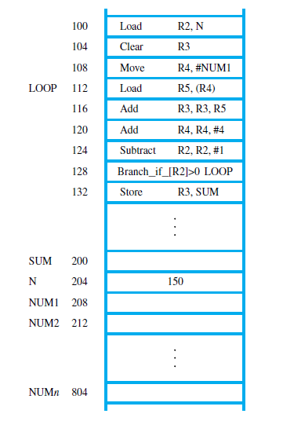
The object program is to be loaded in the main memory.
The figure shows the memory addresses where the machine instructions and the required data items are to be found after the program is loaded for execution.
If the assembler is to produce an object program according to this arrangement,
it has to know
• How to interpret the names
• Where to place the instructions in the memory
• Where to place the data operands in the memory

Slide 6
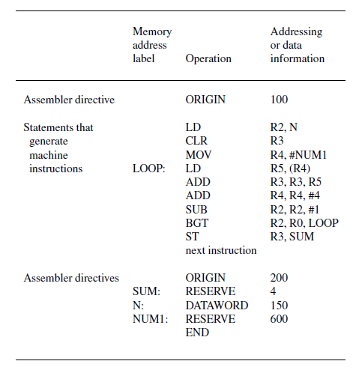
To provide this information, the source program may be written as

Slide 7
The program begins with the assembler directive, ORIGIN, which tells the assembler program where in the memory to place the instructions that follow.
It specifies that the instructions of the object program are to be loaded in the memory starting at address 100.
It is followed by the source program instructions written with the appropriate mnemonics and syntax.
BGT R2, R0, LOOP
to represent an instruction that performs the operation
Branch_if_[R2]>0 LOOP
The second ORIGIN directive tells the assembler program where in the memory to place the data block that follows.

Slide 8
In this case, the location specified has the address 200.
This is intended to be the location in which the final sum will be stored.
A 4-byte space for the sum is reserved by means of the assembler directive RESERVE.
The next word, at address 204, has to contain the value 150 which is the number of entries in the list.
The DATAWORD directive is used to inform the assembler of this requirement.
The next RESERVE directive declares that a memory block of 600 bytes is to be reserved for data.
The last statement in the source program is the assembler directive END, which tells the assembler that this is the end of the source program text.
Try to find more information associated with the program?

Slide 9
Subroutines
In a given program, it is often necessary to perform a particular task or block of instructions many times on different data values.
Such a block of instructions is usually called a subroutine.
When a program branches to a subroutine we say that it is calling the subroutine. The instruction that performs this branch operation is named a Call instruction.
After a subroutine has been executed, the calling program must resume execution, continuing immediately after the instruction that called the subroutine.

Slide 10
The subroutine is said to return to the program that called it, and it does so by executing a Return instruction.
Since the subroutine may be called from different places in a calling program, provision must be made for returning to the appropriate location.
The location where the calling program resumes execution is the location pointed to by the updated program counter (PC) while the Call instruction is being executed.
Hence, the contents of the PC must be saved by the Call instruction to enable correct return to the calling program.
The way in which a computer makes it possible to call and return from subroutines is referred to as its subroutine linkage method.

Slide 11
The simplest subroutine linkage method is to save the return address in a specific location.
Register called the link register is used to branch indirectly through the link register.
The Call instruction is just a special branch instruction that performs the following operations:
• Store the contents of the PC in the link register
• Branch to the target address specified by the Call instruction
The Return instruction is a special branch instruction that performs the operation
• Branch to the address contained in the link register

Slide 12
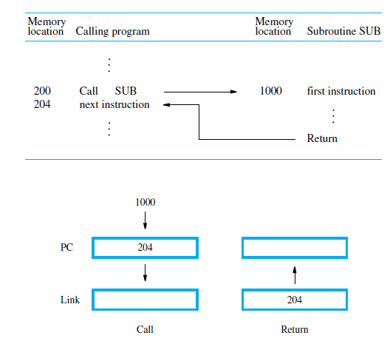

Slide 13
Subroutine Nesting and the Processor Stack
A common programming practice, called subroutine nesting in which the return address of the second call is also stored in the link register, overwriting its previous contents.
It required to save the content of the link register.
Subroutine nesting can be carried out to any depth.
The return address needed for this first return is the last one generated in the nested call sequence. That is, return addresses are generated and used in a last-in–first-out order.

Slide 14
Correct sequencing of nested calls is achieved if a given subroutine SUB1 saves the return address currently in the link register on the stack, accessed through the stack pointer, SP, before it calls another subroutine SUB2.
Then, prior to executing its own Return instruction, the subroutine SUB1 has to pop the saved return address from the stack and load it into the link register.

Slide 15
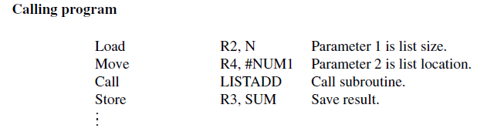
Parameter Passing
Exchange of information between a calling program and a subroutine is referred to as parameter passing.
Processor Stack
Register or Memory Location
Passing parameters through registers is straightforward and efficient.

Slide 16
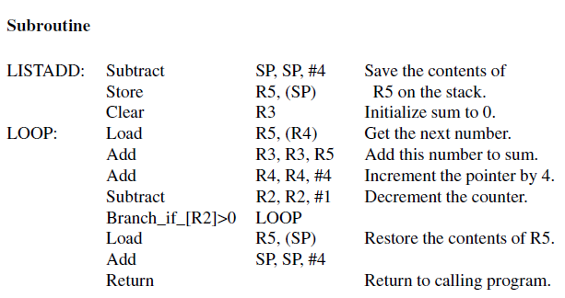
Adding a list of numbers program using subroutine, LISTADD, with the parameters passed through registers.
The size N, and the address, NUM1, of the first number, are passed through registers R2 and R4.

Slide 17
The computed sum is returned to calling program through register R3.
The first four instructions constitute the relevant part of the calling program.
The first two instructions load n and NUM1 into R2 and R4.
The Call instruction branches to the subroutine starting at location LISTADD.
This instruction also saves the return address (i.e., the address of the Store instruction in the calling program) in the link register.
The subroutine computes the sum and places it in R3.

Slide 18
After the Return instruction, the sum in R3 is stored in memory location SUM by the calling program.
In addition to registers R2, R3, and R4, the subroutine also uses R5.
Since R5 may be used in the calling program, its contents are saved by pushing them onto the processor stack upon entry to the subroutine and restored before returning to the calling program.

Slide 19
The Instruction Set
Architecture Level

Slide 20
Programs of high-level languages translated to a common intermediate form—the ISA level—and build hardware that can execute ISA-level programs directly.
The ISA level defines the interface between the compilers and the hardware.
If the compiler writers want some feature that the engineers cannot implement in a cost-effective way, it does not go in.
Similarly, if the hardware folks have some nifty new feature: a memory in which the words whose addresses are prime numbers are super fast.

Slide 21
If developer cannot figure out how to generate code to use it, it will die on the drawing board.
Therefore, an ISA perfectly optimized for the intended programming languages will emerge and be implemented.
When a new machine comes along, any potential customers may ask:
‘‘Is it compatible with its predecessor?’’
‘‘Can I run my old operating system on it?’’
‘‘Will it run all my existing application programs unmodified?’’

Slide 22
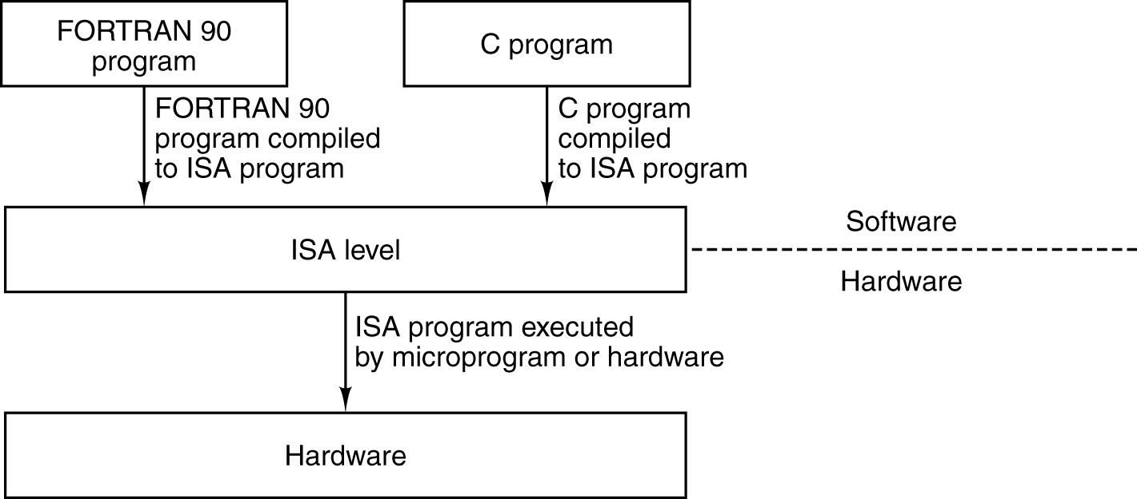
ISA Level
The ISA level is the interface between the compilers and the hardware.
Work as a bridge.
Provide backward compatibility

Slide 23
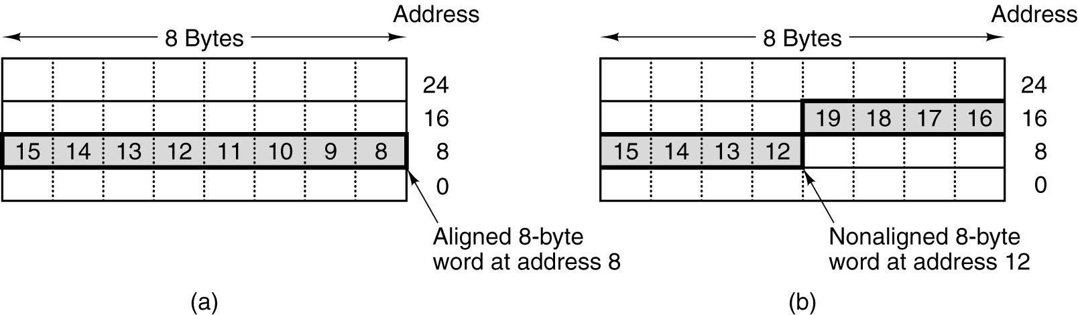
Memory Models
An 8-byte word in a little-endian memory. (a) Aligned. (b) Not
aligned. Some machines require that words in memory be aligned.

Slide 24
Most machines have a single linear address space 0 to, often 2^32 bytes or 2^64 bytes.
Few machines have separate address spaces:
Instructions
Data
This scheme has two advantages:
1. It becomes possible to have 2^32 bytes of program And 2^32 bytes of data while using only 32-bit addresses.
2.It becomes impossible to accidentally overwrite the program, thus eliminating one source of program bugs.

Slide 25
Another aspect : Memory semantics.
It is natural that STORE followed by a LOAD, references the same address, and required the value just stored.
To resolve this, one can perform
Microinstructions reordering
The problem gets even worse in multiprocessor environment.
Multiple CPUs send a stream of (possibly reordered) read and write requests to a shared memory.

Slide 26
Solutions:
All memory requests can be serialized, so each one is completed before the next one is issued.
The program must execute a SYNC instruction, which blocks the issuing of all new memory operations until all the previous ones have completed.
This design have one advantage and one disadvantage:
It gives the hardware designers the maximum freedom to optimize memory usage.
Puts a great burden on the compilers because they have to understand how the underlying microarchitecture works in detail.

Slide 27
Registers
All computers have some registers visible at the ISA level
To control execution,
Hold temporary results,
Some other purposes
ISA-level registers can be divided into two categories:
Special purpose registers and
General-purpose registers
The special-purpose registers include things like the program counter and stack pointer.
The general-purpose registers are there to hold key local variables, and intermediate results of calculations.
Their main function is to provide rapid access to heavily-used data (basically, avoiding memory accesses).

Slide 28
General-purpose registers are completely symmetric and interchangeable.
If the registers are all equivalent, a compiler can use R1 to hold a temporary result, but it can equally well use R25.
The choice of register does not matter.
However, Operating system requires to maintained some convention to use them.
For example, some registers may hold parameters to procedures called and
Others may be used as scratch registers.

Slide 29
If a compiler puts an important local variable in R1 and then calls a library procedure that thinks R1 is a scratch register, when the library procedure returns, R1 may contain garbage.
If there are system-wide conventions on how the registers are to be used, compilers and assembly-language programmers are advised to adhere to them to avoid trouble.
In addition, there are a substantial number of special-purpose registers available only in kernel to control cache, I/O and other hardware.
One hybrid register (user/kernel) mode is flags register or PSW (Program Status Word).

Slide 30
DATA TYPES (Why Important)
A key issue is hardware support for a particular data type.
For instance, accountants have the peculiar habit of writing negative numbers with the minus sign to the right of the number rather than to the left.
Whereas computer scientists put it on leftmost bit.
Now suppose that in an effort to impress his boss, the head of the computer center at an accounting firm changed all the numbers in all the computers to use the rightmost bit (instead of the leftmost bit) as the sign bit.
The hardware expects a certain format for integers and does not
work properly when given anything else.

Slide 31
    Now suppose we need to verify the federal debt.
    Using 32-bit arithmetic would not work here because the numbers involved are larger than 2^32 (about 4 billion).
    One solution is to use two 32-bit integers to represent each number, giving 64 bits in all.
    If the machine does not support this kind of double precision number, all arithmetic on them will have to be done in software.
    But the two parts can be in either order since the hardware does not care.
Therefore, It is very important to find out the hardware support for data types.

Slide 32
At the ISA level, Data types can be divided into two categories:
Numeric and nonnumeric.
Numeric data types are the integers, typically 8, 16, 32, and 64 bits.
Some computers support unsigned integers as well as signed integers.
Numbers, such as 3.5, floating-point numbers have lengths of 32, 64, or sometimes 128 bits.
Most computers have instructions for doing floating point arithmetic.
Many computers have separate registers for holding integer operands and for holding floating-point operands.

Slide 33
Along with this it also have Nonnumeric Data Types to support non numerical applications,
The most common character codes are
ASCII and
UNICODE
Boolean values are also important.
In practice, a byte or word is used per Boolean value because individual bits in a byte do not have their own addresses and thus are hard to access.

Slide 34
A common system uses the convention that 0 means false and everything else means true.
The one situation in which a Boolean value is normally represented by 1 bit is when there is an entire array of them, so a 32-bit word can hold 32 Boolean values.
Such a data structure is called a bit map and occurs in many contexts.

Slide 35
INSTRUCTION FORMATS
An instruction consists of
Opcode, along with operands.
There can be zero, one, two, or three addresses present.
On some machines, all instructions have the same length; on others there may be many different lengths.
Instructions may be shorter than or longer than the word length.
If all instructions have same length:
Decoding is easier
but often wastes space

Slide 36
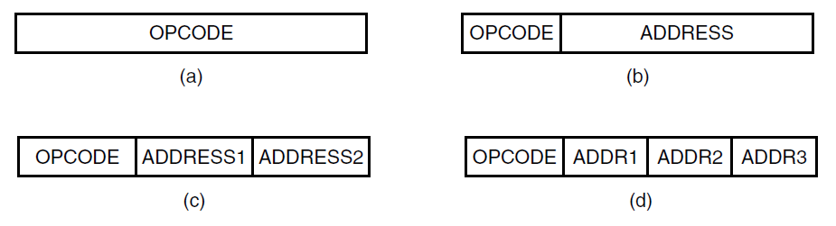
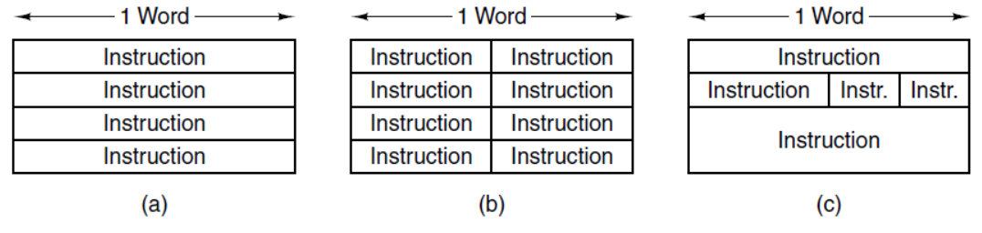

Slide 37
Design Criteria for Instruction Formats
Number of factors need to be consider while choosing the instruction format.
For example, if memory accesses are fast, a stack-based design is good one.
However, if slow, then having many registers is the way to go.
Short instructions are better than long ones. A program consisting of n 16-bit instructions takes up only half as much memory space as n 32-bit instructions.

Slide 38
  Memory Band width: inability of the memory system to supply instructions and operands as rapidly as the processor can consume them.
  The rate at which instructions can be executed (i.e., the processor speed) may be limited by the instruction length. Shorter instructions means a faster processor.
A second design criterion is sufficient room in the instruction format to express all the operations desired.
A machine with 2^n operations with all instructions smaller than n bits is impossible.
A third criterion is number of bits in an address field.
Consider a machine with an 8-bit character with main memory that can hold 2^32 characters.

Slide 39
The designers could choose to assign consecutive addresses to units of 8, 16, 24, or 32 bits.
Let Suppose two different variants of the scheme:
one, making the 8-bit byte the basic unit of memory
And 32-bit word.
The former have a memory of 2^32 bytes( 0, 1, 2, 3, ..., 4,294,967,295) whereas latter would have a memory of 2^30 words (0, 1, 2, 3, ..., 1,073,741,823)
To compare two characters in the 32-bit word organization, the program would not only have to fetch the words containing the characters but would also have to extract each character from its word in order to compare them.

Slide 40
The 8-bit organization, on the other hand, provides an address for every character, thus making the comparison much easier.
The 32-bit word requires only 2^30 separate addresses, giving an address length of only 30 bits, whereas the 8-bit byte proposal requires 32 bits to address the same memory.
These are some consideration points.

Slide 41
Expanding Opcodes

Slide 42
INSTRUCTION TYPES
ISA level instructions can be approximately divided into a half dozen of groups
Every computer has a few unusual instructions, added for compatibility with previous models
General Types are:
Data Movement Instructions
Dyadic Operations
Monadic Operations
Comparisons and Conditional Branches
Procedure Call Instructions
Loop Control
Input/Output

Slide 43
Data Movement Instructions
Possible sources for a data item
memory or register
and possible destinations for a data item
memory or register
Data movement instructions must somehow indicate the amount of data to be moved.
In some ISAs variable quantities of data movement ranging from 1 bit to the entire memory allowed.
On fixed-word-length machines, the amount to be moved is often exactly one word.
Any more or less must be performed by a software routine using shifting and merging.
Some variable-word-length machines have instructions specifying only the source and destination addresses but not the amount.

Slide 44
Dyadic Operations
Dyadic operations are those that combine two operands to produce a result:
Addition, Subtraction, Multiplication, and Division
Another group of dyadic operations includes the Boolean instructions.
  One such application: a 32-bit-word-length machine in which four 8-bit characters are stored per word. Suppose we want to print only second character.
Change the rightmost 8 bits of a 32-bit word without disturbing the other 24 bits

Slide 45
Monadic Operations
Monadic operations have one operand and produce one result
shift or rotate the contents
Moving zero is a special case of the general move data instructions
CLR operation, with only one address
Adding 1 to a word is also commonly used for counting.
INC operation, which adds 1.
NEG operation is Negating X is really computing 0 − X

Slide 46
Comparisons and Conditional Branches
The most common condition to be tested is whether a particular bit in the machine is 0 or not.
overflow bit
carry bit etc.
Comparing two words or characters to see if they are equal or, if not, which one is greater is also important
One subtle point relating to comparing numbers is deciding whether or not the numbers should be considered signed or not.
000 100 (smallest)
001 101
010 110
011 111
100 000
101 001
110 010
111 011 (largest)

Slide 47
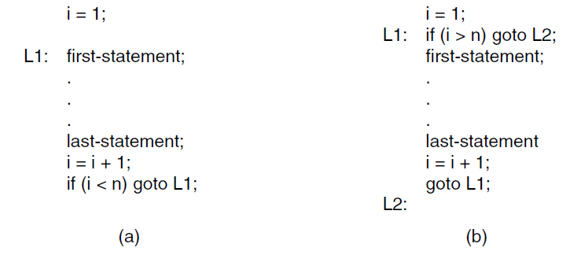
Procedure Call Instructions
The term subroutine is often used instead of procedure, especially when referring to assembly language programs.
Loop Control

Slide 48
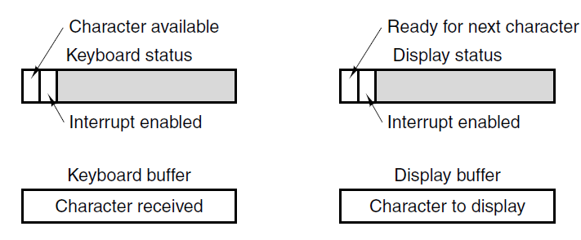
Input/ Output
Three different I/O schemes are in current use:
    1. Programmed I/O with busy waiting.
    2. Interrupt-driven I/O.
    3. DMA I/O.
Disadvantage of programmed I/O is that the CPU spends most of its time in a tight loop waiting for the device to become ready, known as busy waiting.

Slide 49
To get rid of busy waiting we can use interrupt driven I/O.
By setting the INTERRUPT ENABLE bit in a device register, the software can request that the hardware give it a signal when the I/O is completed.
Although interrupt-driven I/O is a big step forward compared to programmed I/O but the problem is “ an interrupt is required for every character transmitted”.
The solution lies in going back to programmed I/O, but having somebody else do it.
DMA (Direct Memory Access) controller. A simple chip to perform the task of I/O.
The DMA chip has (at least) four registers inside it, all of which can be loaded by software running on the CPU.

Slide 50
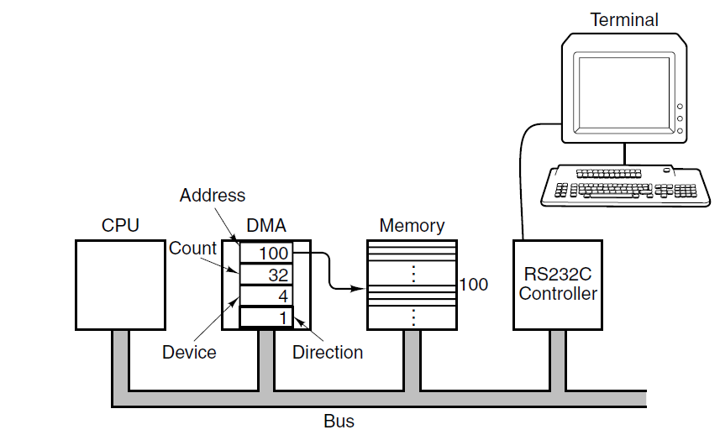
The first one contains the memory address to be read or written.
The second one contains the count of how many bytes (or words) are to be transferred.
The third one specifies the device number or I/O space address to use, thus specifying which I/O device is desired.
The fourth one tells whether data are to be read from or written to the I/O device.

Slide 51
Pentium 4

Slide 52
Memory Organization
Memory is byte-addressable using 32-bit addresses.
Instructions operate on 8 or 32 bits data, these operand sizes are called byte and doubleword in Intel terminology.
A 16-bit operand was called a word in earlier 16-bit Intel processors.
For double-precision floating-point numbers, a larger 64-bit operand size called a quadword is used.
Little-endian addressing is used.
Multiple-byte data operands may start at any byte address location.
They need not be aligned with any particular address boundaries in the memory.

Slide 53
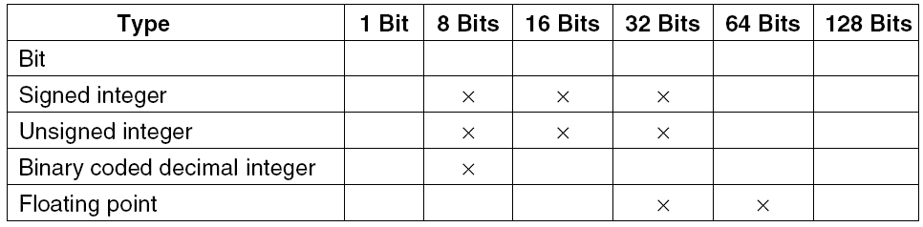
Data Types

Slide 54
Register Structure
Eight 32-bit general-purpose registers, to hold data or addressing information.
They have unique names.
Eight additional registers are available for floating-point instructions also used by the multimedia instructions.
Set of registers are used by vector-processing instructions.
The IA-32 architecture has different models for accessing the memory.

Slide 55
The segmented memory model is used.
Each segment associated with different areas of the memory.
These are code segment; holds the instructions of a program,
stack segment; processor stack,
and four data segments; for holding data operands.
The six segment registers contain selector values for each segment.
Flat memory model of the IA-32 architecture, where a 32-bit address can access a memory location anywhere in the code, processor stack, or data areas, the segment registers are initialized with selector values that point to address 0 in the memory.

Slide 56
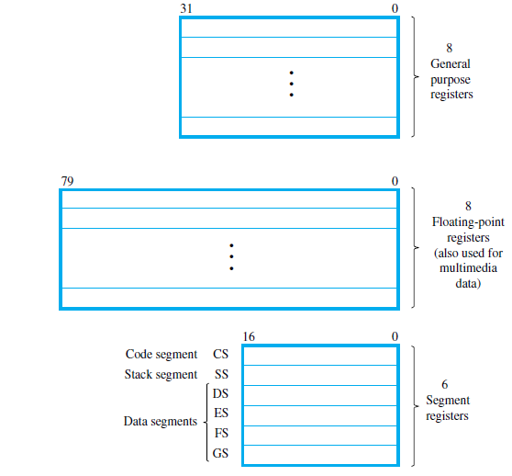

Slide 57
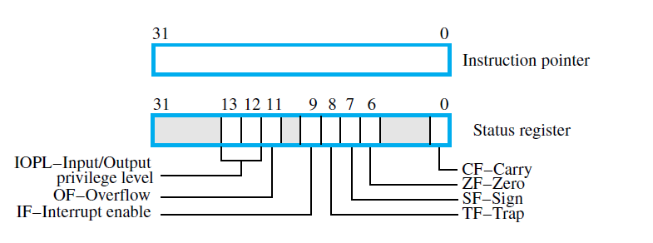
The two; program counter, and status register
The program execution mode bits (IOPL, IF, TF) are associated with input/output operations and interrupts.

Slide 58
The IA-32 general-purpose registers are compatibility with earlier 8-bit and 16-bit Intel processors.
In those processors, there are some restrictions regarding the use of certain registers.
The eight general-purpose registers are grouped into three different types:
data registers for holding operands,
pointer registers for holding addresses,
and index registers for holding address indices.
The pointer and index registers are used to determine the effective address of a memory operand.
In 8-bit processors, the data registers were called A, B, C, and D.
In later 16-bit processors, these registers were labeled AX, BX, CX, and DX.

Slide 59
The high- and low-order bytes are identified by suffixes H and L.
For example, the two bytes in register AX are referred to as AH and AL.
In IA-32 processors, prefix E is used for extended 32-bit registers: EAX, EBX, ECX, and EDX.
These changes are done to provide compatibility.

Slide 60
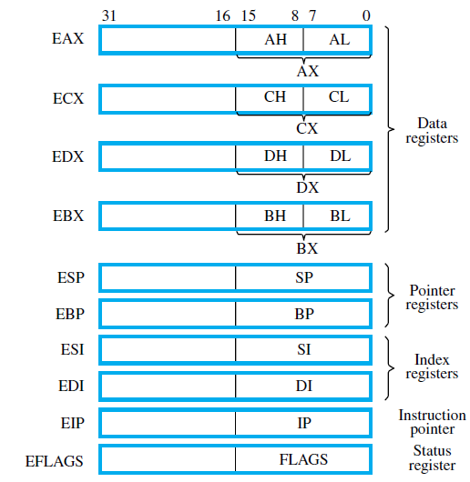

Slide 61
Instructions
The IA-32 instruction set is extensive.
It is encoded in a variable-length instruction format that does not have a fully regular layout.
Most instructions have either one or two operands.
In the two-operand case, only one of the operands can be in the memory.
The other must either be in a processor register or be an immediate value in the instruction.
Instructions are provided for moving data between the memory and the processor registers, performing arithmetic operations, and performing logical and shift/rotate operations.

Slide 62
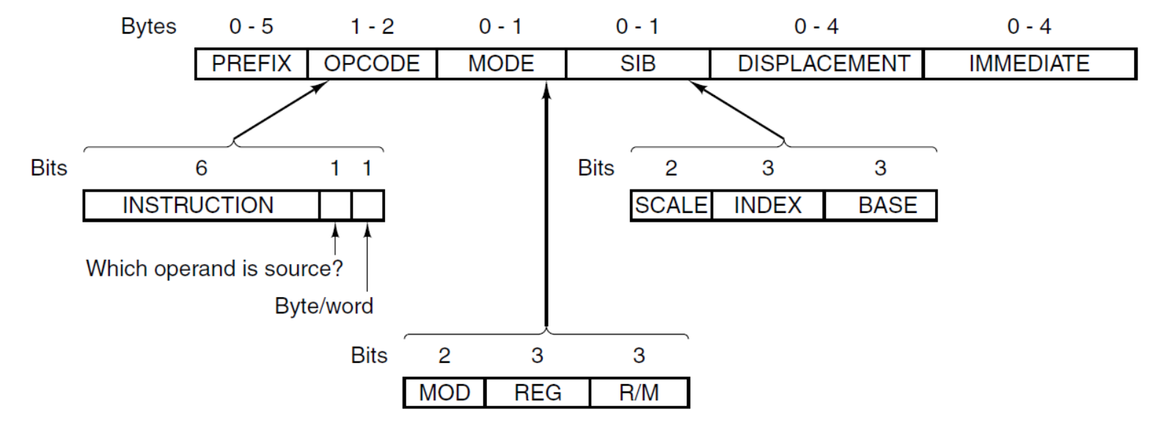
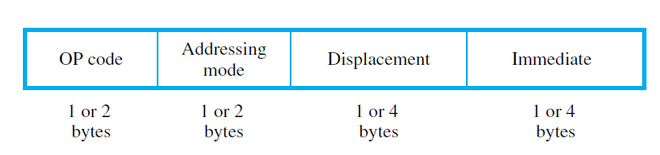
Jump instructions and subroutine call/return instructions are included.
Push and pop operations for manipulating the processor stack are also directly supported in the instruction set.

Slide 63
The Pentium 4 instruction have up to six variable-length fields, five of which are optional.
In general, for two-operand instructions, if one operand is in memory, the other may not be in memory.
A prefix byte is an extra opcode stuck onto the front of an instruction to change its action.
The only structure in the opcode field is the use of the low order bit in some instructions to indicate byte/word, and the use of the adjoining bit to indicate whether the memory address (if it is present) is the source or the destination.

Slide 64
Following the opcode byte in most instructions that reference an operand in memory is a second byte that tells all about the operand.
These 8 bits are split up into a 2-bit MOD field and two 3-bit register fields, REG and R/M.
Sometimes the first 3 bits of this byte are used as an extension for the opcode, giving a total 11 bits for the opcode.
However, the 2-bit mode field means that there are only four ways to address operands and one of the operands must always be a register.

Slide 65
Logically, any of EAX, EBX, ECX, EDX, ESI, EDI, EBP, ESP should be specifiable as either register, but the encoding rules prohibit some combinations and use them for special cases.
Some modes require an additional byte, called SIB giving Scale, Index, Base), This scheme is not ideal, but a compromise given the competing demands of backward compatibility and the desire to add new features not originally envisioned.
In addition to all this, some instructions have 1, 2, or 4 more bytes specifying a memory address (displacement) and possibly another 1, 2, or 4 bytes containing a constant (immediate operand).

Slide 66
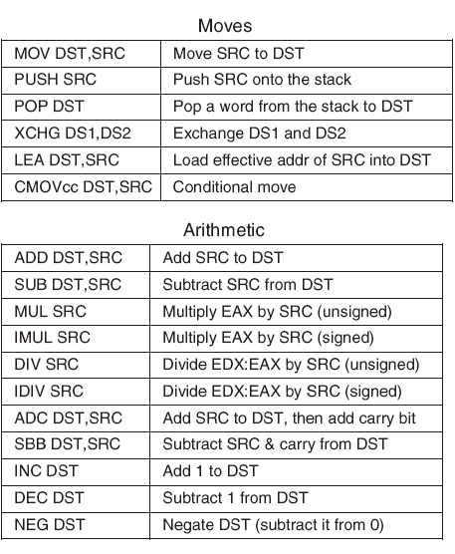
The Pentium 4 Instructions (1)
A selection of the Pentium 4 integer instructions.

Slide 67
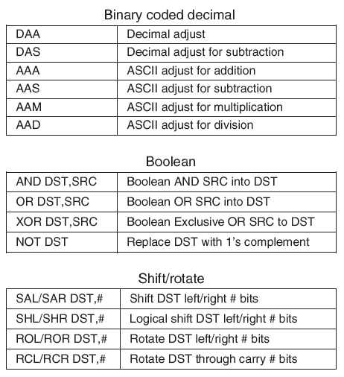
The Pentium 4 Instructions (2)
A selection of the Pentium 4 integer instructions.

Slide 68
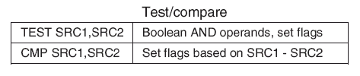
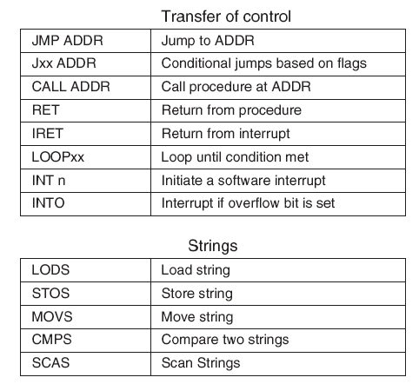
The Pentium 4 Instructions (3)
A selection of the Pentium 4 integer instructions.

Slide 69
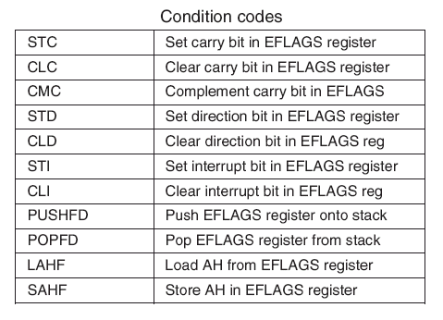
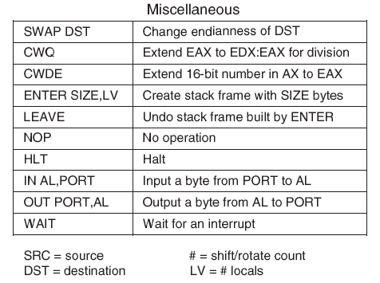
The Pentium 4 Instructions (4)
A selection of the Pentium 4 integer instructions.

Slide 70
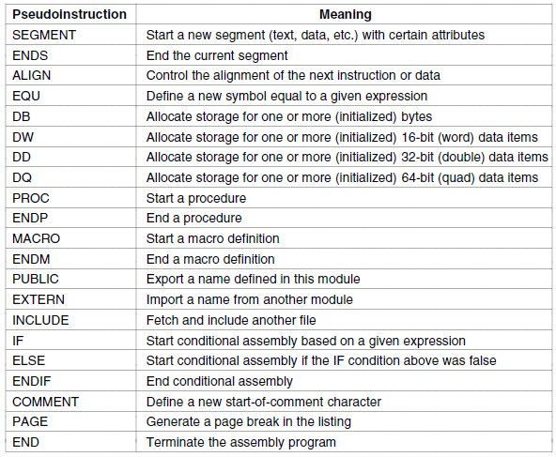
Assembler Directives or Command

